Slide 1
Introduction
Chapter 1
What is Corporate Finance?
The basic types of financial management decisions and the role of the financial manager.
The various forms of business organization and their the financial implications.
The Goal of the Financial Manager.
The Agency Problem and Control of the Corporation.
The conflicts of interest that can arise between owners and managers.

Slide 2
What Is Corporate Finance?
The basic types of financial management decisions and the role of the financial manager.
Corporate Finance addresses the following three questions:
  What long-term investments should the firm choose?
  The investment decision.
  2. How should the firm raise funds for the selected investments?
  The financing decision.
  3. How should short-term assets be managed and financed?
  Working capital decision.

Slide 3
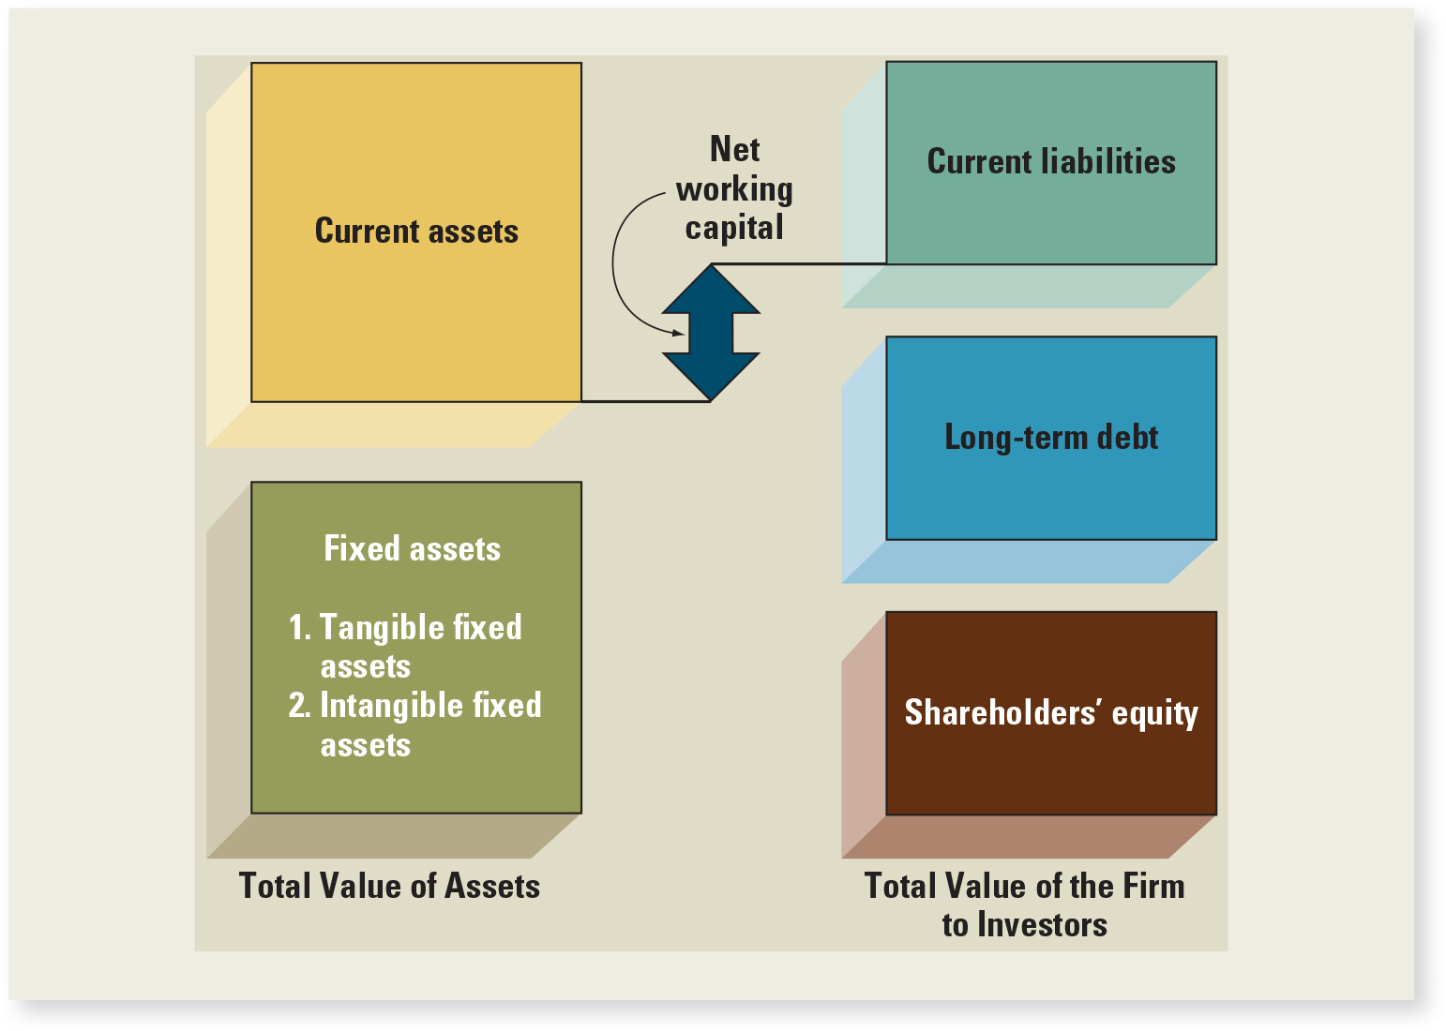
Balance Sheet Model

Slide 4
The Capital Budgeting Decision (Investment Decision)
Current Assets
Current Liabilities
Long-Term Debt
Fixed Assets
1 Tangible
2 Intangible
Shareholders’ Equity
  What long-term investments should the firm choose?

Slide 5
The Capital Structure Decision (Financing Decision)
Current Assets
Current Liabilities
Long-Term Debt
How should the firm raise funds for the selected investments?
Fixed Assets
1 Tangible
2 Intangible
Shareholders’ Equity

Slide 6
Short-Term Asset Management (Net Working Capital)
Current Assets
Current Liabilities
Net Working Capital
Long-Term Debt
Fixed Assets
1 Tangible
2 Intangible
  How should short-term assets be managed and financed?
Shareholders’ Equity

Slide 7
The Financial Manager
The Financial Manager’s primary goal is to increase the value of the firm by:
Selecting value creating projects
Making smart financing decisions

Slide 8
The various forms of business organization
The Sole Proprietorship.
The Partnership.
  General Partnership.
  Limited Partnership.
The Corporation.

Slide 9
Sole Proprietorship
The business is owned by one person.
The least regulated form of organization.
Owner keeps all the profits but assumes unlimited liability for the business’s debts.
Life of the business is limited to the owner’s life span.
Amount of equity raised is limited to owner’s personal wealth.

Slide 10
Partnership
The business is formed by two or more owners.
All partners share in profits and losses of the business and have unlimited liability for debts. (General partnership)
Easy and inexpensive form of organization.
Partnership dissolves if one partner sells out or dies.
Amount of equity raised is limited to the combined personal wealth of the partners.
Income is taxed as personal income to partners.

Slide 11
Corporation
A business created as a distinct legal entity composed of one of more individuals or entities.
Most complex and expensive form of organization.
Shareholders and management are usually separated.
Ownership can be readily transferred.
Both equity and debt finance are easier to raise.
Life of a company is not limited.
Owners (shareholders) have limited liability.

Slide 12
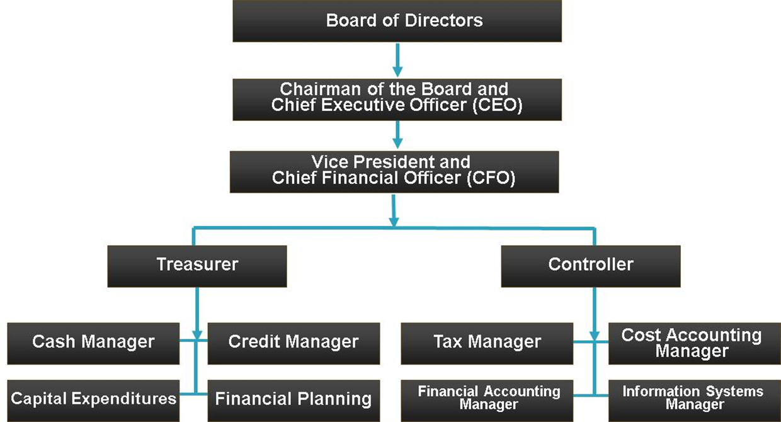
Hypothetical Organization Chart
Access the text alternative for slide images

Slide 13
A Comparison of Corporations and Partnerships
 | Corporation | Partnership
Liquidity | Shares can be easily exchanged | Subject to substantial restrictions
Voting rights | Usually, each share gets one vote | General partner is in charge; limited partners may have some voting rights
Taxation | Double | Partners pay personal taxes on partnership profits
Reinvestment and dividend payout | Broad latitude | All net cash flow is distributed to partners
Liability | Limited liability | General partners may have unlimited liability; limited partners enjoy limited liability
Continuity | Perpetual life | Limited life
Notes:
Corporations exist around the world under a variety of names. Table 1.2 lists several well-known companies, along with the type of company in the original language.

Slide 14
The Goal of Financial Management (Firm objective)
What is the correct goal?
  Survival.
  Avoid bankruptcy.
  Beat the competition. Bigger market share
  Maximize profit
  Minimize costs
  Maximize sale or market share
  Maintain steady earning growth.
Each of these goals presents problems.
These goals are either associated with increasing profitability or reducing risk.
They are not consistent with the long-term interests of shareholders.
It is necessary to find a goal that can encompass both profitability and risk.

Slide 15
Firm’s Objective
  The goal of financial management is to maximize shareholders’ wealth.
  Shareholders’ wealth can be measured as the current value per share of existing shares.
  This goal overcomes the problems encountered with the goals outlined earlier.
What is the appropriate goal for financial management when the firm has no traded shares?
‘Maximise the market value of the owner’s equity’
Good financial decisions increase the market value of the owner’s equity, while poor financial decisions decrease it.

Slide 16
The importance of Cash Flow
To create value, the firm must generate more cash than it uses.
The importance of size, timing and riskiness of cash flow.
Cash flow is different from net income.

Slide 17
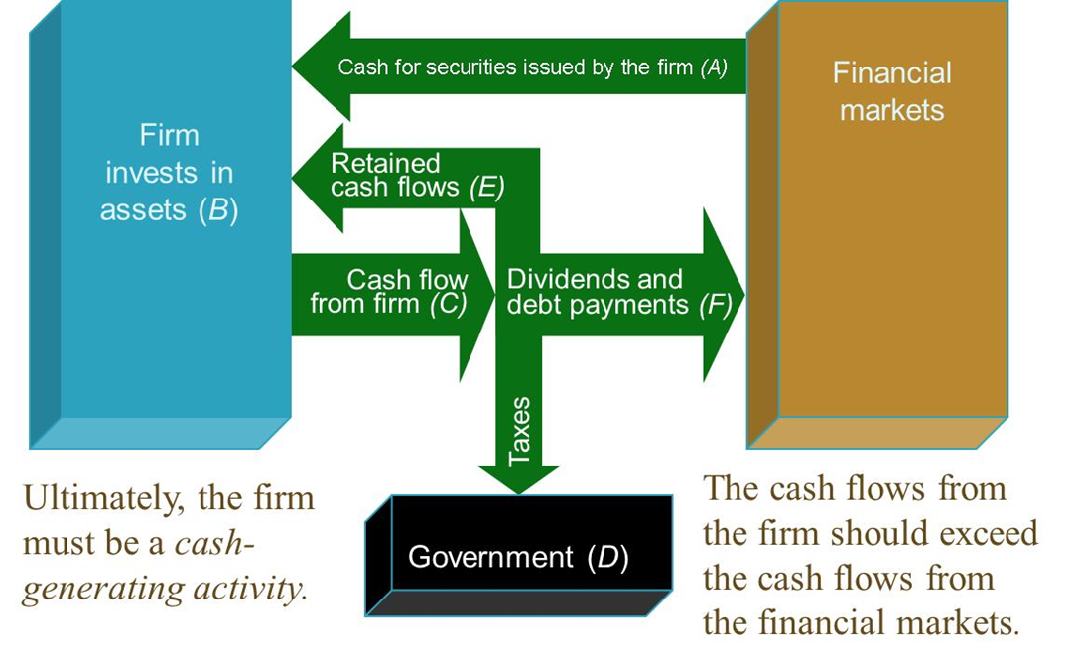
Cash flow between the Firm and Financial Markets
Notes:
It is important to remind students that net income is NOT cash flow.

Slide 18
Do manager act in shareholders interest?
The answer will depend on:
How closely management goals are aligned with shareholder goals.
The ease with which management can be replaced if it does not act in shareholders’ best interests.

Slide 19
Managerial Goals
Managerial goals may be different from shareholder goals
  Expensive perquisites
  Survival
  Independence
Increased growth and size are not necessarily equivalent to increased shareholder wealth

Slide 20
The Agency Relationship, Problem and costs
Agency relationship
  Principal hires an agent to represent his/her interest.
  Stockholders (principals) hire managers (agents) to run the company.
Agency problem
  Conflict of interest between principal and agent.
  Agency costs
  The direct and indirect costs arising from this conflict of interest.

Slide 21
Managing Managers
Managerial compensation schemes
  Incentives can be used to align management and stockholder interests
  The incentives need to be structured carefully to make sure that they achieve their intended goal
Corporate control
  The threat of a takeover may result in better management
Other stakeholders

Slide 22
Regulation
The Securities Act of 1933 and the Securities Exchange Act of 1934
  Issuance of Securities (1933)
  Creation of SEC and reporting requirements (1934)
Sarbanes-Oxley (“Sarbox”) (2002)
  Increased reporting requirements and responsibility of corporate directors

